Slide 1




FHA Architecture
Update
FHA Architecture and Modeling WG
July 10, 2012

Slide 2
List of Topics for the upcoming Technical Workgroup Meetings

Slide 3
Interoperability architecture
  Discussion points
    What is interoperability architecture
    Different federal entities and example health related priorities
    Sample use case data exchange
      Example components at the various layers that take part in this data exchange process
    Questions:
      What all needs to be mapped as a part of interoperability architecture
        platforms
        projects
        needs
        Data elements
        Standards
      Discussion around current approach
        What is the FHA team’s current approach?
        How can we make the process better ?
        What additional information would be beneficial

Slide 4
Information modeling
  Current approaches
    HL7 RIM based modeling , other methods
  Participants
    Federal Agencies
    Private Organizations
      HIEs, RHIOs etc.
  FHIM– Steve Wagner
  Best practices

Slide 5
Federal Health Information Model
S&I Framework
  FHIM introduction
  S&I framework introduction
  Where they are in Sync
  Areas where harmonization is required
  Methodology

Slide 6
Health Domain and NIEM
  NIEM introduction
  NIEM Health Domain
  How it can help healthcare community
  What is required
  Discussion

Slide 7
FEA CRM discussion
  What is FEA and the CRM
  Subgroup findings
    Review process for future versions
    Examples of Use
    Potential uses
  OMB stance on how they want to receive feedback and what is the intended use of BRM
  Review DOD /VA iBRM

Slide 8
Other Potential Topic Areas
Meaningful use
Pending Legislations
HIPAA/PHI
Unique identifiers
Mobile considerations
Shared Services
EHR

Slide 9
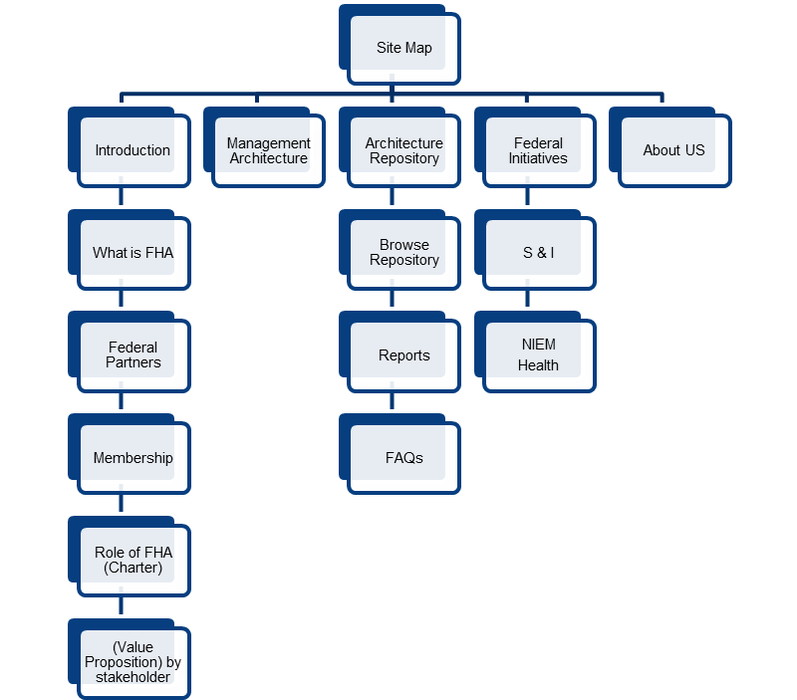
Portal Update
FHA Portal Concept

Slide 10
Portal Update
HHS extraction specifications
Decision Matrix
Current Status
Next Steps

